Slide 1

Document Verification using
Blockchain
DOC-BLOCK

Slide 2



Supervised By ,
Shaikh Akib Shahriyar
Lecturer
Dept. of CSE,KUET
Iftekhar Toufique Imam
Roll : 1607040
Yamin Arafat
Roll : 1607032

Slide 3

DOC_BLOCK
WHAT
WHY
Our developed system, DOC-Block is to create a fast-reliable secured File share and verification system
Hard/Soft copy a document can easily be manipulated thus verification of a document becomes tedious
WHAT
WHY
HOW
HOW
Storing and Matching Hash between documents in Blockchain

Slide 4
Objectives
To make a fully decentralized platform for file verification.
To compare between different files precisely.
To make a secured decentralized the file sharing system.
To take the challenge of developing an Blockchain app.

Slide 5

Why use Blockchain ?
Peer-to-Peer
Decentralized
Distributed application architecture that partitions tasks or workloads between peers
The data is distributed (i.e. duplicated) across many computers, and the whole blockchain is entirely decentralized
High Security
Hash
Decentrlized,There’s no one single point of entry for hackers.
Blockchain uses strong hashing method.
5

Slide 6

Technology Used
SHA – 256 Hashing Method
Blockchain
Ethereum
Inter Planetary File System IPFS

Slide 7

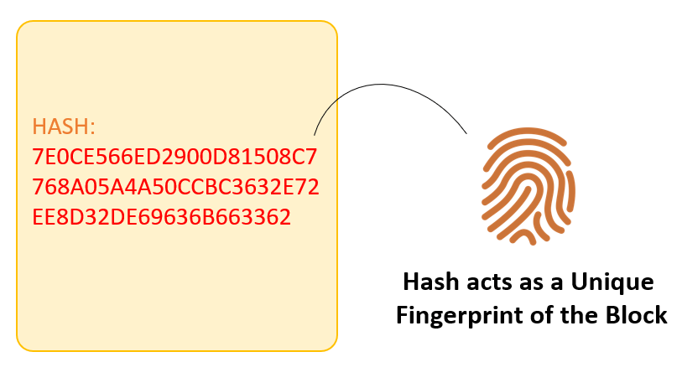
Hash
What is Hash?
A hash can be understood as a fingerprint which is unique to each input.

Slide 8
Hash
Why we use Hash ?
Hash functions are used all over the internet in order to securely store passwords, find duplicate records, quickly store and retrieve data, and more.
No matter the input, the output is always the same size(256 bits).
A simple change in the input file (even an extra space) will change the output hash totally.

Slide 9
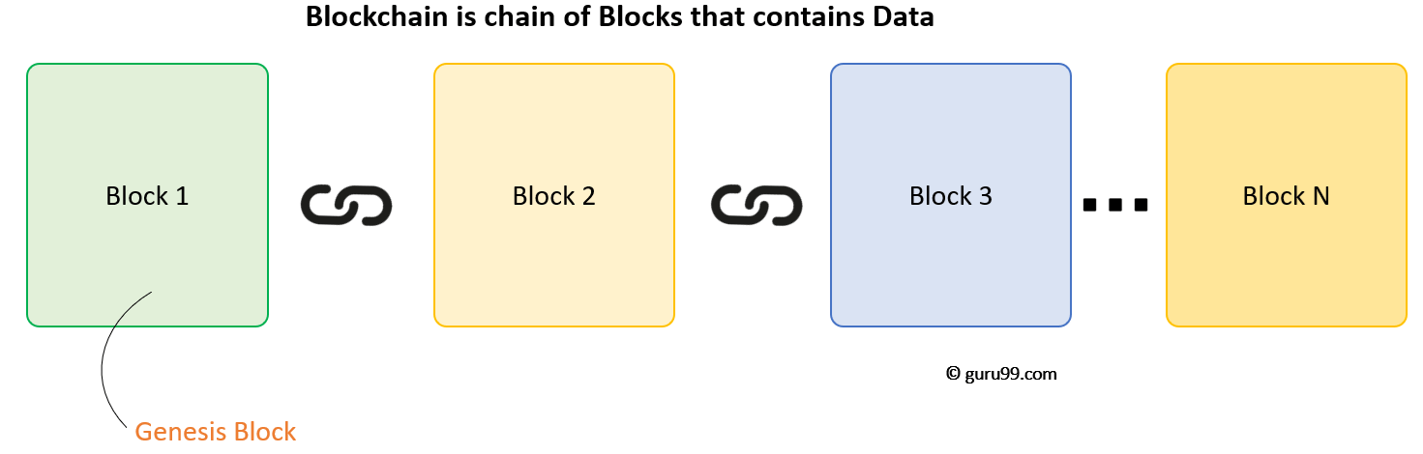
Blockchain
What is Blockchain ?
A Blockchain is a decentralizes, distributed, and often times public, digital ledger.
For use as a distributed ledger, a Blockchain is typically managed by a peer-2-peer network.

Slide 10
Blockchain
Properties of Blockchain :
Each block has :
Data
Hash
Hash of the previous block
Once recorded, the data in any given block cannot be altered retroactively without alteration of all subsequent blocks.
This allows the participants to verify and audit transaction independently and relatively inexpensively.
Each blocks hold batches of valid transactions including the cryptographic hash linking the two.

Slide 11
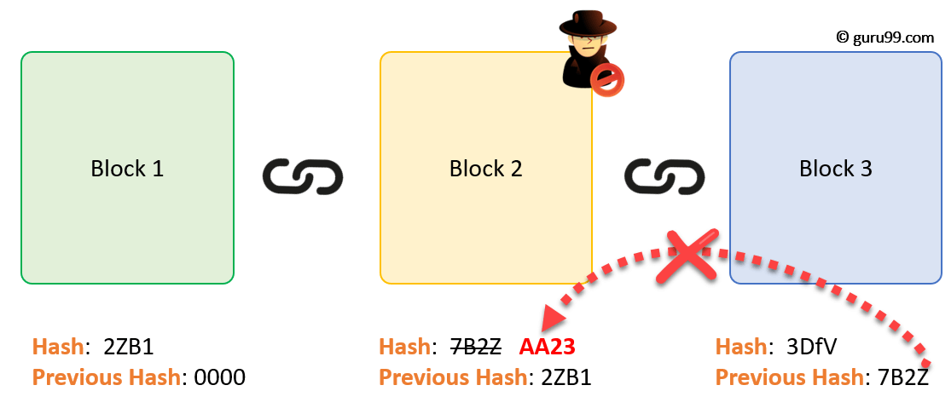
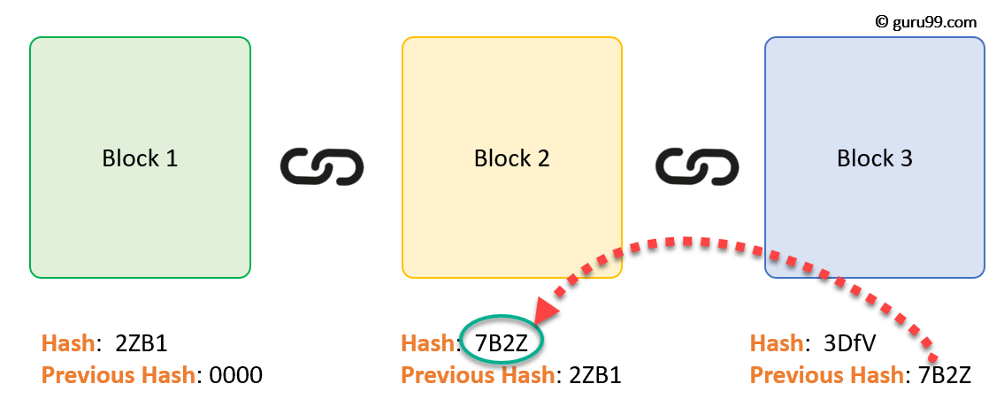
Blockchain
How it woks?
The 1st block has no predecessor, block 2 contains the hash of block 1. While block 3 contains the hash of block 2 and so on.
Assume an attacker is able to change the data present in block 2.Correspondingly the hash of block also changes. But block 3 still contains the old hash of the block 2.This makes block 3,and all succeeding blocks invalid.

Slide 12

Ethereum
What is Ethereum ?
Ethereum is an open-source & public blockchain based distributed computing platform for building decentralized applications.
We used Ethereum to deploy our smart contract written in Solidity Language

Slide 13

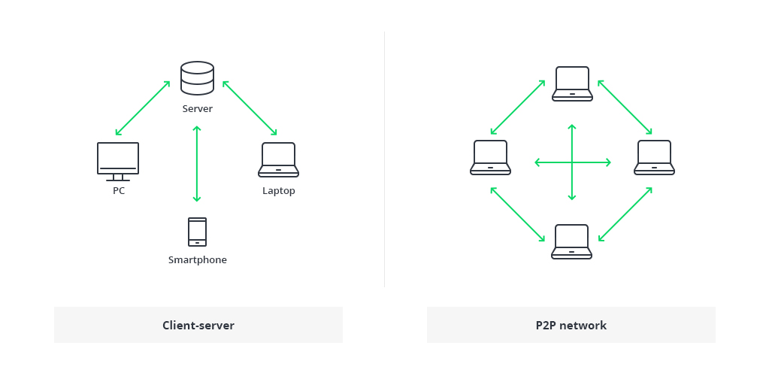
Ipfs
What is IPFS ?
How it works ?
The Inter Planetary File System is a peer-2-peer network for storing and sharing data in a distributed file system.
IPFS allows user not only to receive but host content, in a similar manner to BitTorrent.
IPFS asks the network to find the blocks that are storing the content behind that file’s hash.

Slide 14
Features
Download uploaded documents using IPFS hash
Add Hash of a document in blockchain.
Add Documents
Download Documents
Log In
Verify Documents
Wallet Manager
Existing users need to submit their name before accessing the system.
Verify a document with ample information.
Manage Ethereum coin using metamask
10

Slide 15
Implementation
We deployed our smart contract in Ethereum Testnet
Used Node.js and Web3.js for creating the website
Added Sign up, Add Document, Verify Document functionality using the smart contract
Added Download functionality using IPFS
Deployed the Website in Heroku
Our Website is live!

Slide 16
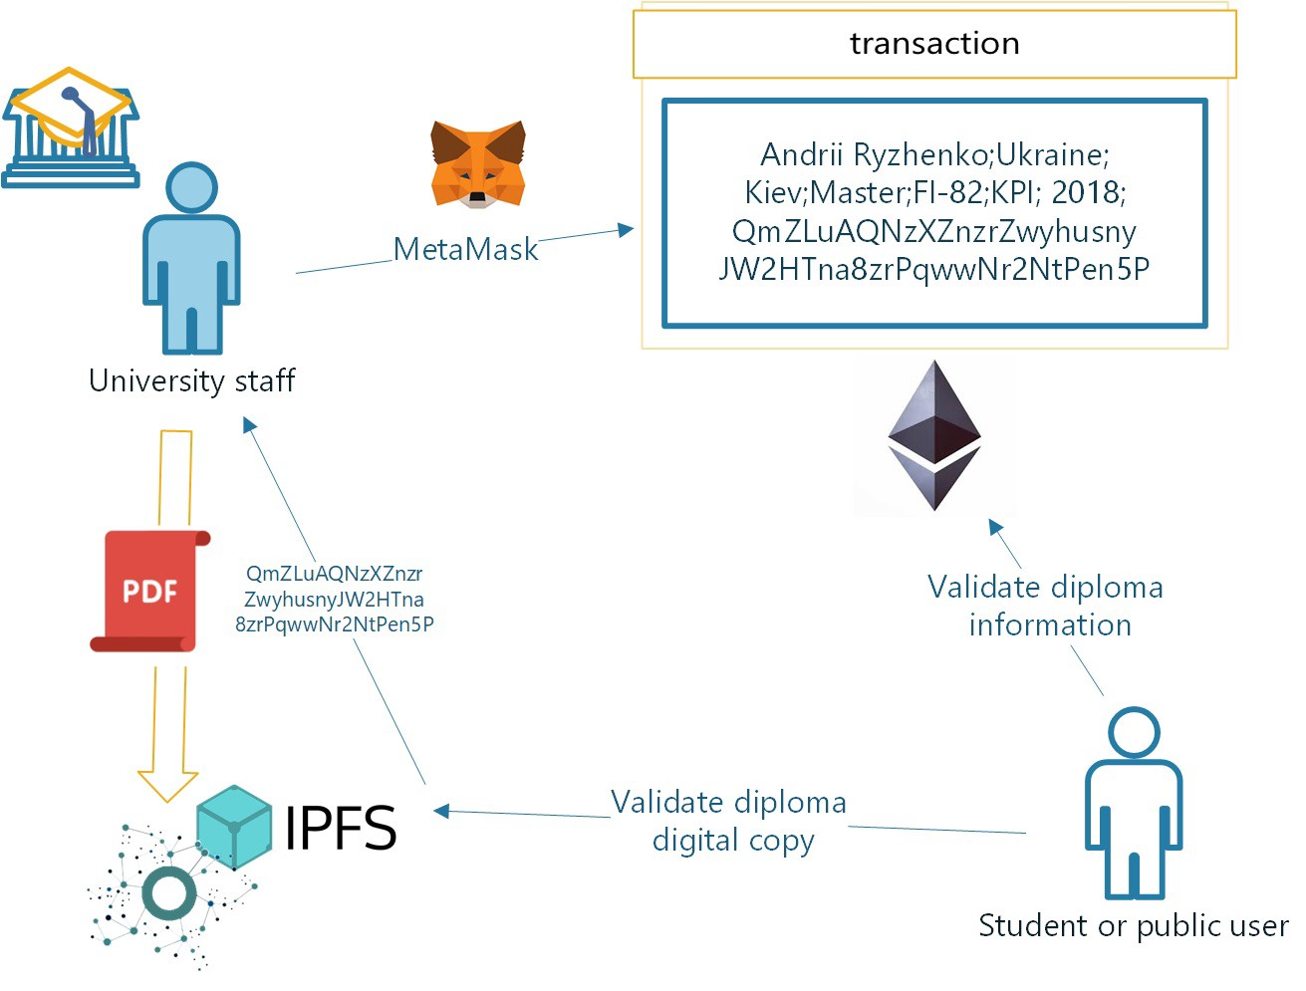
Workflow

Slide 17
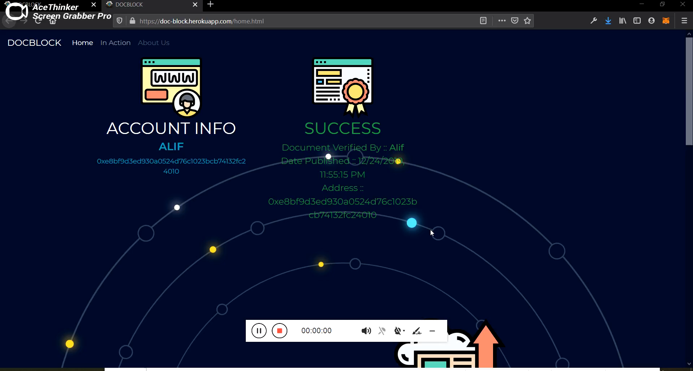
Demo

Slide 18
Limitations
Required Crypto to use our website
Each user need to sign up / No guest account support
Small amount of crypto needed is required to add and sign up
IPFS will clear the files if small node are seeding the file

Slide 19
Future Plan
FUTURE scope
Making the processs more flexiable by using guest support.
Generating and deploying contract with user defined restrcitions.
Including Admin bases document add feature.
Making walltet manager more user friendly.
Notes:
© Copyright PresentationGO.com – The free PowerPoint and Google Slides template library

Slide 20
SWOT Analysis
S
STRENGTH
Decentralized
Secured
Efficient
Reliable
WEAKNESSES
Requires Crypto
Slow compared to centralized
W
O
OPPORTUNITIES
Application in various Institution
Application in public sectors
THREATS
Quantum Supremacy
T

Slide 21
Conclusion
SHA – 256 Hashing Method is one way and collision resistant made the file verification secured and reliable
Use of blockchain made the functionality of our secured and reliable
Whole process is secured that it is impossible for hacker to manipulate any document or hacking the website
Thus this project stands strongly in the basis of strong secured way of document verification

Slide 22
Questions ? ☺

Slide 23
The End

